Slide 1
Medicare is as Sustainable as We want it to be
Embargoed until 3:00 PM October 30, 2012
Michael M Rachlis MD MSc FRCPC LLD (Hon)
Comments on Canadian Institute for Health Information National Health Expenditures Trends Report October 30, 2012
www.michaelrachlis.ca

Slide 2
Current received wisdom
Health Care costs are wildly out of control
My fellow baby boomers and I will really deep six Medicare as we get older
The only alternatives are to either cut real services or use more private care and finance.
We need an “adult conversation” to reduce our expectations and make the cut backs required

Slide 4
What’s my story?
What’s the diagnosis
  Health Care costs are not “out of control”
  The aging population won’t break the bank
  Most of health care’s problems are due to antiquated, processes of care
What are the solutions
  We need to complete the Second Stage of Medicare -- a patient-friendly delivery system focussed on keeping people healthy

Slide 5
Health Care costs are not out of control

Slide 6
But Health care hasn’t
been starved either

Slide 7
What does the latest Canadian Institute for Health Information tell us about health spending http://www.cihi.ca

Slide 8
What does the latest CIHI report tell us about health spending
Public health care spending is taking a slightly larger share of our economy and of provincial government spending compared with 10 to 20 years ago
However, health care costs have been falling for the past 2 years as a share of the economy and of provincial spending – The Cost curve bent 2-3 years ago!
Canadian government spending as a share of the economy has fallen sharply over the past 25 years
Canada spends about the same share of its economy on health care as other similar wealthy countries and much less than the US

Slide 14
The sustainability of Medicare in Canada
Health slowly increased its % of Canadian GDP from 2000-2008
Health’s share of GDP rose dramatically in 2009 because the economy collapsed.
In 2010 and 2011, governments controlled costs, the economy grew again, and health decreased its share of GDP
This downward trend of health costs as a share of GDP will likely continue for the next 3 years
2012 public health care spending of 8.1% of GDP is estimated to be 0.7% higher than in 1992, or 10% in relative terms
Private sector costs have risen 1.0% since 1992, or 40% in relative terms

Slide 15
The shrinking Canadian public sector
Overall Canadian government revenues have fallen by 5.7% of GDP from 2000 to 2011, the equivalent of over $100 Billion in foregone revenue
At 38.4% of GDP, Canadian government revenues are at their lowest level since 1980.
  Just 3% of Canada’s GDP, could either eliminate all 2012 Canadian government deficits OR fund: first dollar universal pharmacare, long term care and home care AND regulated child care for all parents who want it AND free university tuition AND 15,000 units of affordable housing units AND the new fighter jets
Notes:
Canadian Department of Finance Fiscal Reference Tables. Table 51. October 2012. Accessed at: http://www.fin.gc.ca/frt-trf/2012/frt-trf-12-eng.pdf. Canadian government tax and non-tax receipts were 44.1% of GDP in 2010 and 38.4 of GDP in 2011.
Canada’s 2010 GDP was $1,623 Trillion according to the Canadian Institute for Health Information National Health Expenditures. November 2011. Accessed at: http://secure.cihi.ca/cihiweb/products/nhex_trends_report_2011_en.pdf. Appendix A.1.
From Table A.3.2.1 November 2011. Accessed at: http://secure.cihi.ca/cihiweb/products/nhex_trends_report_2011_en.pdf.
Total private payments for prescription drugs estimated to be $14.2 billion in 2010.
Total private payments for other institutions (Long term care) $5.6B in 2010
The Ontario home care association estimated that approximately 500,000 to 1,000,000 Canadian adults used private home care services at an average cost of $23 per visit. Assuming 100 visits per year the cost would be between $1.15 billion and $2.3 billion. Assume twice the uptake for an estimated cost of $4.5B See: Private home care – a vital component of the health care continuum in Ontario. September 2010. Accessed at: http://www.homecareontario.ca/public/docs/publications/position%20papers/2010/private-home-care-vital-component-health-care.pdf.
Childcare Canada estimates that approximately 20% of eligible children 0-5 yrs are in regulated spaces at present public cost of $3B. If we assume uptake by 80% of the others this would require an extra $9B. See: Early Childhood Education and Care in Canada 2008: Trends and analysis. Accessed at: http://www.childcarecanada.org/pubs/other/trends_analysis08/ECEC08_Trends_Analysis_QuickFacts.pdf.
Statistics Canada estimates total college and university tuition fees were $7.7 Billion in 2009. Assume $8.0B for 2010 See:
http://www40.statcan.ca/l01/cst01/GOVT31A-eng.htm.
Assuming average cost of $200,000 per housing unit. From Wellesley Institute report Precarious Housing In Canada. Toronto. 2010.
See: http://www40.statcan.ca/l01/cst01/GOVT31A-eng.htm page 76.
A March 10, 2011 Parliamentary Budget Office paper concluded PBO report estimates that the average cost for each of Canada's 65 F-35 fighter jets will be $148.5 million in Fiscal 2009 dollars or approximately 70% higher than the government’s estimates. The PBO estimates costs of $29B over 30 yrs. For the purposes of this exercise assume twice the expense per plane for approximately $2B per year. See:
http://www.flightglobal.com/articles/2011/03/10/354228/canada-f-35-cost-estimate-soars-66-report.html.
Grand total: $46.3 Billion

Slide 19
The aging population won’t kill Medicare
Canada is aging and health costs increase with age
But Aging of the population per se has had and will have only a moderate impact on health expenditures
Aging is like a glacier not a tsunami. We have lots of time to prepare and adapt our health system before we get swamped!
  The elderly are healthier than ever
  High performing health systems can hold costs while enhancing quality of care for the frail elderly

Slide 20
The elderly are healthier than ever
The elderly are living longer than ever
We do not have accurate data on the Canadian prevalence of elderly disability
We do have fairly accurate US and European data and they show positive signs

Slide 21
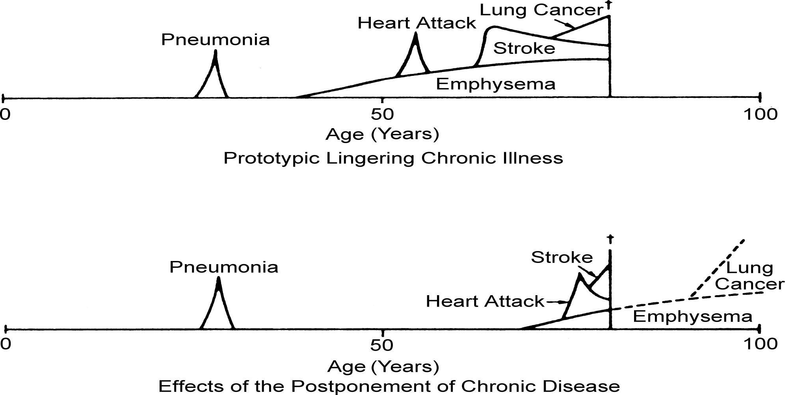
Death
Death
Frailty
The Compression of Morbidity
JF Fries. Millbank Memorial Fund Quarterly. 1983.

Slide 22
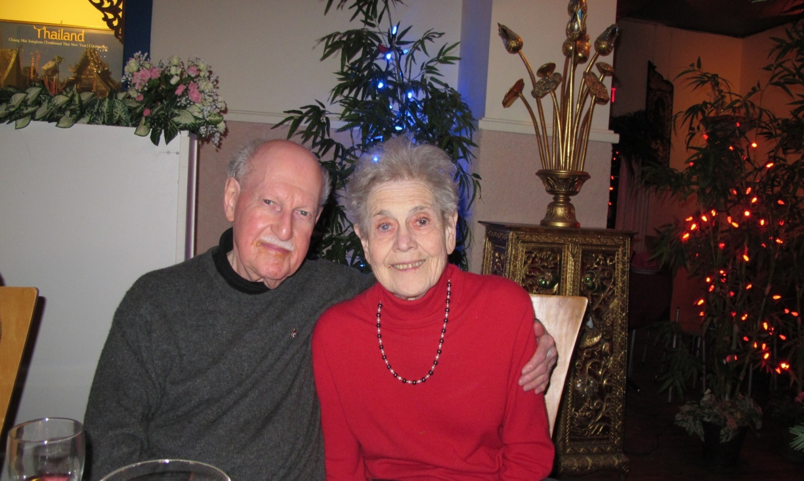
Health costs are related to illness and Canadian seniors are healthier than ever

Slide 23
American prevalence of disabled elderly 1984 - 2004
Year Disability | 1984 | 1989 | 1994 | 1999 | 2004
No Disability | 73.8% | 75.2% | 76.8% | 78.8% | 81.0%
Light or Moderate | 15.9% | 14.8% | 13.9% | 13.3% | 11.8%
Severe Requiring > 2.5 hrs personal care daily | 10.3% | 10.0% | 9.2% | 7.9% | 7.2%
Manton et al. PNAS. 2006:103(48):18734-9

Slide 24
Dependency of the elderly in wealthy countries
 | 2005-2010 | 2025-2030 | 2045-2050
Old Age Dependency Ratios (OADRs) | 0.28 | 0.41 | 0.53
Prospective Old Age Dependency Ratios (POADRs) | 0.19 | 0.23 | 0.27
Adult Disability Dependency Ratios (ADDRs) | 0.11 | 0.12 | 0.12
W Sanderson. Science. 2010;329:1287-8. Canada was not included

Slide 25
Annual impact of Aging on health costs 2010-2036
From Mackenzie and Rachlis 2010

Slide 26
“It is not the aging of our population that threatens to precipitate a financial crisis in health care, but a failure to examine and make appropriate changes to our health care system, especially patterns of utilization.”
Dr. William Dalziel. CMAJ. 1996;115:1584-6

Slide 27
Most of health care’s problems are due to antiquated, processes of care

Slide 28
After-Hours Care and Emergency Room Use
Difficulty getting after-hours care without going to the emergency room
Used emergency room in past two years
Percent
Source: 2011 Commonwealth Fund International Health Policy Survey of Sicker Adults in Eleven Countries.

Slide 29
Waited Less Than a Month to See Specialist
Percent
Base: Saw or needed to see a specialist in the past two years.
Source: 2011 Commonwealth Fund International Health Policy Survey of Sicker Adults in Eleven Countries.

Slide 30
Spine surgeons in Ontario: A wasted precious resource
Only 10% of patients referred to a spine surgeon actually need surgery
$24 million in unnecessary MRI scans
(http://www.theglobeandmail.com/news/opinions/editorials/spine-surgery-can-become-much-more-efficient/article2023173)

Slide 31



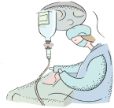

Traditional Joint Replacement Referral Process
Spaghetti junction!

Slide 32
There are affordable solutions to all of Medicare’s apparently intractable problems: The Second Stage of Medicare

Slide 33
We need to change the way we deliver services
“Removing the financial barriers between the provider of health care and the recipient is a minor matter, a matter of law, a matter of taxation. The real problem is how do we reorganize the health delivery system. We have a health delivery system that is lamentably out of date.”
Tommy Douglas 1982

Slide 34
“I am concerned about Medicare – not its fundamental principles -- but with the problems we knew would arise. Those of us who talked about Medicare back in the 1940’s, the 1950’s and the 1960’s kept reminding the public there were two phases to Medicare. The first was to remove the financial barrier between those who provide health care services and those who need them. We pointed out repeatedly that this phase was the easiest of the problems we would confront.”
Tommy Douglas 1979
Catching Medicare’s second stage

Slide 35
“The phase number two would be the much more difficult one and that was to alter our delivery system to reduce costs and put the emphasis on preventative medicine….
Canadians can be proud of Medicare, but what we have to apply ourselves to now is that we have not yet grappled seriously with the second phase.”
Tommy Douglas 1979

Slide 36
The Second Stage of Medicare is delivering health services differently to keep people well

Slide 37
Health Promotion intervention for BC frail elders
Outcome at 3 yrs Group | Living in the community | Resident of a LTC facility or dead
Health Promotion Group (N=81) | 75.3% (61) | 24.7% (20)
Control Group (N=167) | 58.7% (98) | 42.3% (69)
(P = 0.04) N Hall et al. Canadian Journal on Aging. 1992;11(1):72-91

Slide 38
Step right up!
Get your ELIXIR of
Health Promotion!
Reduce your risk of dying or ending up in a nursing home by over
40%!
Increase your chances of staying in your own
home by nearly
30%!

Slide 39
With current resources Canadians could:
Have elective surgery within two months
Have elective specialty input within one week
Have same day access to our regular family doctor or someone on the doctor’s team

Slide 40
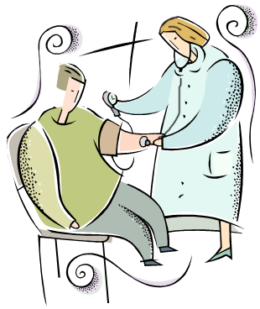
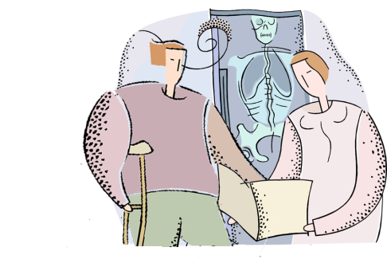



Toronto Arthroplasty Model
Referring Physician
Central Intake
Assessment
Advanced Practice Physio
Surgeon
Consult
Surgery
Post-Op Discharge Follow-Up
Holland Centre
and
Toronto Western
Holland Centre
Mt. Sinai
St. Michael’s
St. Joseph’s
Toronto East General
Toronto Western
Holland Centre

Slide 41
Good News in Hamilton, Winnipeg, Nova Scotia, etc! We could have elective specialty input into patients’ care within 7 days
  The Hamilton Family Medicine Mental Health Program increased access for mental health patients by 1100% AND decreased psychiatry outpatients’ clinic referrals by 70%.
  The program staff includes 22 psychiatrists, 129 family physicians, 114 Nurses and Nurse Practitioners, 20 Registered Dietitians, 77 Mental Health Counsellors, 7 pharmacists and provides care to 250,000 patients
Notes:
41

Slide 42
Good News in Cambridge, Cape Breton, Penticton, etc! We could access primary health care within 24 hrs
In Cambridge, Dr. Janet Samolczyk aims to see her patients WHEN they want to be seen including within 24 hours
Notes:
42

Slide 43
There is substantial evidence that for profit patient care tends to cost more and is of poorer quality -- but the most salient argument is Tony Soprano’s:
“Fuhgetaboutit!”
We don’t need it.

Slide 44
Summary:
Health Care costs are not out of control
The aging population won’t break the bank
Medicare was and is good public policy
Our health system’s problems reflect our failure to implement the Second Stage of Medicare
As we embrace Medicare’s Second Stage, we are finding affordable solutions to all of our apparently intractable problems

Slide 45

Courage my Friends, it is Not Too Late to Make a Better World!
Tommy Douglas
(paraphrasing Tennyson)

